Slide 1
DHIS2 Version 40: Upgrading the National Trainer of Training (ToT) Workshop
Adama, Feb. 13, 2024

Slide 2
Outline
Introduction
Rational for version upgrades and other updates
Customization process
Key Changes in metadata, data entry, visualization, and analytics
New futures for DHIS2 version 40
Challenges and Considerations
Next Steps and Priorities

Slide 3
Introduction
Overview of current DHIS2 implementation status
  Version 2.27 implemented in 2018
  Upgraded to versions 2.30 and 2.36
  55% of health facilities now online
  30,763 facilities & 1,103 admin units using system
  Capacity Building: Continuous training and support provided to healthcare personnel for effective DHIS2 utilization.

Slide 4
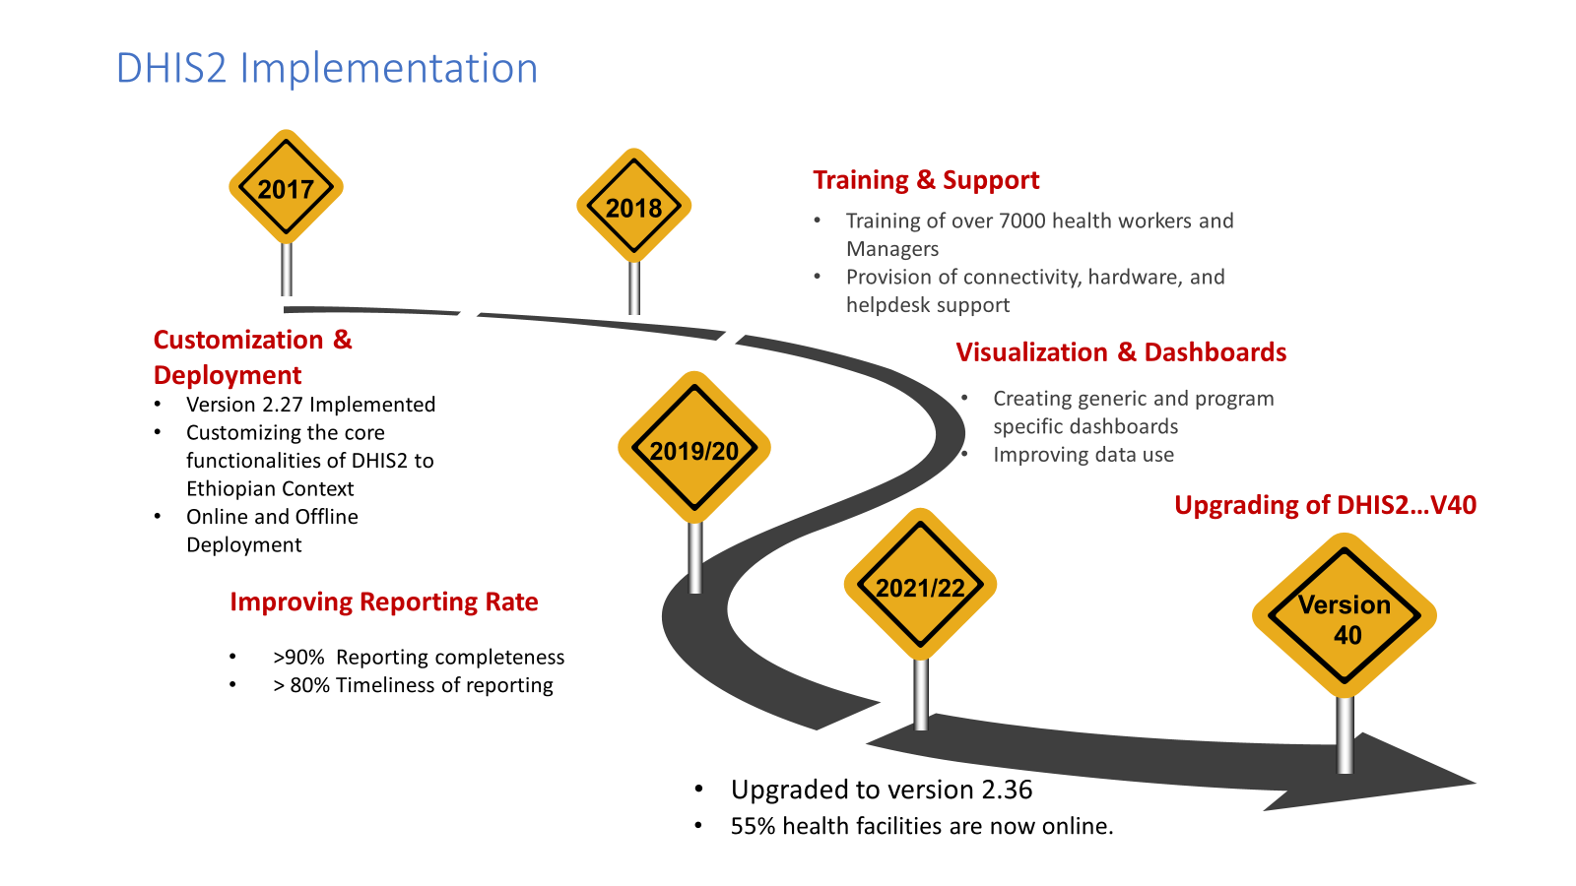

Slide 5

Reasons for upgrading to v 40
Fix metadata and data quality issues
Get latest analytics features
Better community support
Redeployment Dilemma: the high cost and complexity of redeploying DHIS2 v2.36 with fixes for offline facilities.
Cost-Effectiveness: DHIS2 v40 upgrade eliminates the need for expensive redeployment and offers valuable new features

Slide 6



Process steps for Customization
Conducted two rounds of the 15-day workshop
Used MoH and regional experts for metadata cleaning , customization and overall testing
Conducted Nonfunctional , Functional pilot testing, User acceptance Testing and Technical Training

Slide 7
Process Steps for Customization
Step 1: Identifying Issues:
Review and categorize DHIS2's Known issues into 16 key areas
Step 2: Crafting a Plan:
Develop action plan with defined tasks and timelines
Step 3: Team Grouping:
Form groups based on their individual expertise
Step 4: Setting Standards:-
Establish a dedicated team to define data quality standards and Review
Step 5: Strong Monitoring:
Regularly monitor and assess ongoing activities

Slide 8

Major issues resolved in relation to metadata
Category options: 307 of the 634 initial category options were retained after review and removal of redundancies.
Categories: Initially, 253 categories were identified for cleaning, with 134 high-priority categories chosen for inclusion in the data collection.
Category Combinations: Out of 271 category combinations, 136 were accepted after team review and revision.
Standardized naming: Consistent naming procedures are implemented for all metadata.
Removed duplicate indicators, data elements, and validation rules
Fix formula issues for indicator calculation

Slide 9
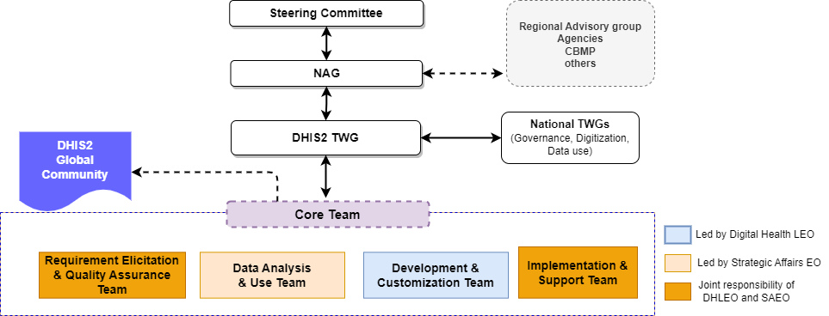
Developing the DHIS2 governance protocol and implementation roadmap
Completing the final draft of the DHIS2 governance protocol
Initiating the development of a draft implementation roadmap

Slide 10





DHIS2 Governance Protocol: Key Messages
Defines roles and responsibilities for requirement gathering, development, customization, and data use.
Outline procedures for user management, access controls, and data sharing.
Establishes standards for development, upgrade, integration, and interoperability.
Specifies infrastructure requirements and a readiness checklist.
Ensures smooth operations, user satisfaction, data-driven decisions, and health system support.

Slide 11
Key Changes in metadata, Data Entry, Visualization, and Analytics

Slide 12


Access to the DHIS2 staging server
URL :https://hmis-staging.moh.gov.et/dhis
Username and password:
Your production username and password
For CBMP University:- Username:-test
Password:-Test43_86@9

Slide 13
Standardizing Naming Conventions for Data Elements and Indicators
Added prefixed before the actual name ( useful in filtering a long list of name).
Enhance clarity and ease of interpretation for analysis and reporting.
Form Name:
  Appears solely in data entry forms.
  No anticipated modifications (identical to reporting forms).
  Example: "Total number of pregnant women that received four or more antenatal care contacts by Maternal Age"
Name:
  Used for data analysis and reporting.
  Character limit: 255 characters.
  Example: "MAT_ANC >= 4 by Maternal Age "
Short Name:
  Used for graphical visualizations and concise presentations.
  Ideal for graphs, maps, and other presentations.
  Character limit: 50 characters.
  Example: " ANC >= 4 by Maternal Age“
Procedure to Change Name to Short Name:
  Navigate to: Settings > User Settings > Property to Display in Analysis Module > Short Name

Slide 14
Validation Rules
An expression that defines a relationship between a number of data elements
Expression has Left side, right side and an operator
Common operators are: less than, equal to or greater than
You create Validation Rules based on what you know to be true
e.g.
‘Malaria RDT positive’ should always be LESS THAN ‘Malaria RDT tested’

Slide 15

Validation Rules…Continued
Total Validation Rules: 626
Valuation Groups = 18
Added prefixed before the actual name of the validation rules.
Determine the importance of the validation rule as
  Low…5
  Medium…226
  High…395 (Most of them are Hospital KPIs related data elements)
Grouped validation rules based on the thematic area.
  This group is what you will select in Validation Rule Analysis
  The output will test every rule in the Group and show you EVERY TIME a rule was violated within your specified time and place!
validation rules across data set work only in the data quality app.
https://docs.google.com/spreadsheets/d/16bM8vubRiqN3u58ZW3QIsaoEVH5nqJ1o/edit#gid=1113344084

Slide 16
Routine Data Entry
Introducing Control Groups :
  30 control groups were added to the monthly reporting dataset.
  All control groups are closed by default.
Benefits:
  Service availability data for program improvement including private HFs.
  Enhanced data analysis capabilities to service availability monitoring.
All data entry datasets are to be closed after 3 months.
Rationale:
  Defines a timeframe for data entry completeness.
  Facilitates accurate reporting and analysis with finalized data.
  Ensures data consistency and prevents conflicting updates.
Next : Steps
  Train users on identifying and utilizing control groups.
  Communicate the closure policy and its benefits to stakeholders.

Slide 17
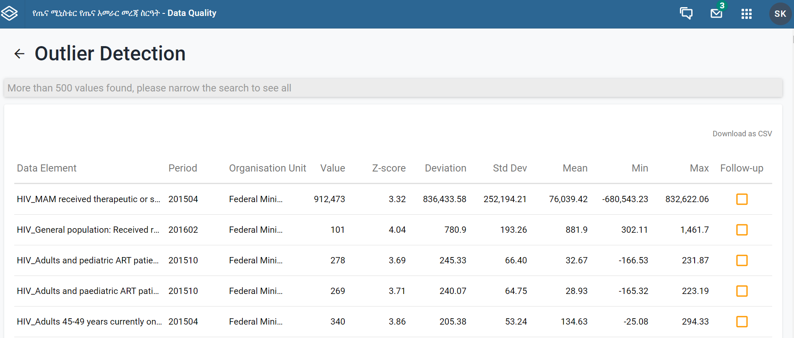
Data Quality (Core App)
Validation Rule Analysis:
  Powerful tool for cross-comparing various data elements across different datasets.
Outlier Detection:
  Utilizes both Z-score and modified Z-score methods for comprehensive outlier identification.
  Enables targeted investigation and data corrections when needed.
Follow-Up Analysis:
  Streamlined flow for further analysis and resolution of identified data issues.
Notes:
Open the Data Quality app and click Outlier Detection.
Select one or multiple data sets.
Select Organisation units.
Multiple organisation units can be selected. The analysis is made on raw data for all organisation units in the sub-hierarchy of the selected units, not on aggregated data.
Select From date and To date.
Set the Algorithm to use.
Z-score (based on the mean of data values), Modified Z-score (based on the median of data values) and Min-max values (based on stored min-max data values) are available algorithms.
Select a Threshold.
This refers to the number of standard deviations the data is allowed to deviate from the mean before it is classified as an outlier.
Select Max results.
This refers to the maximum number of outliers listed in the results.
(Optional) Select a Data start date and Data end date
These fields can be used to perform outlier detection analysis on a subset of the data within the provided date range. When left blank, the natural start and end date of the dataset will be used (in advanced section).
(Optional) Select a measure to Sort by.
The outliers can be sorted by Z-score or by Absolute deviation from Mean (in advanced section).

Slide 18
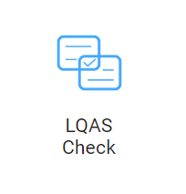
LQAS (Data Accuracy) Check
A New App for Enhanced Accuracy Assessments:
  Randomly selects 12 samples from the dataset for verification.
  Compares manual registration counts with reported values in the based-on Lot Assurance Decision Table.
  Offers downloadable reports in various formats for flexibility and documentation.
  Implements an audit trail for transparent tracking of all accuracy checks.

Slide 19
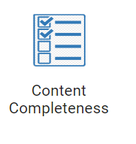
Content Completeness
Automated Calculation:
  The system automatically calculates the percentage of content completeness.
  Provides a clear overview of data comprehensiveness.
  Downloadable reports in various formats are available for convenient analysis and sharing.

Slide 20
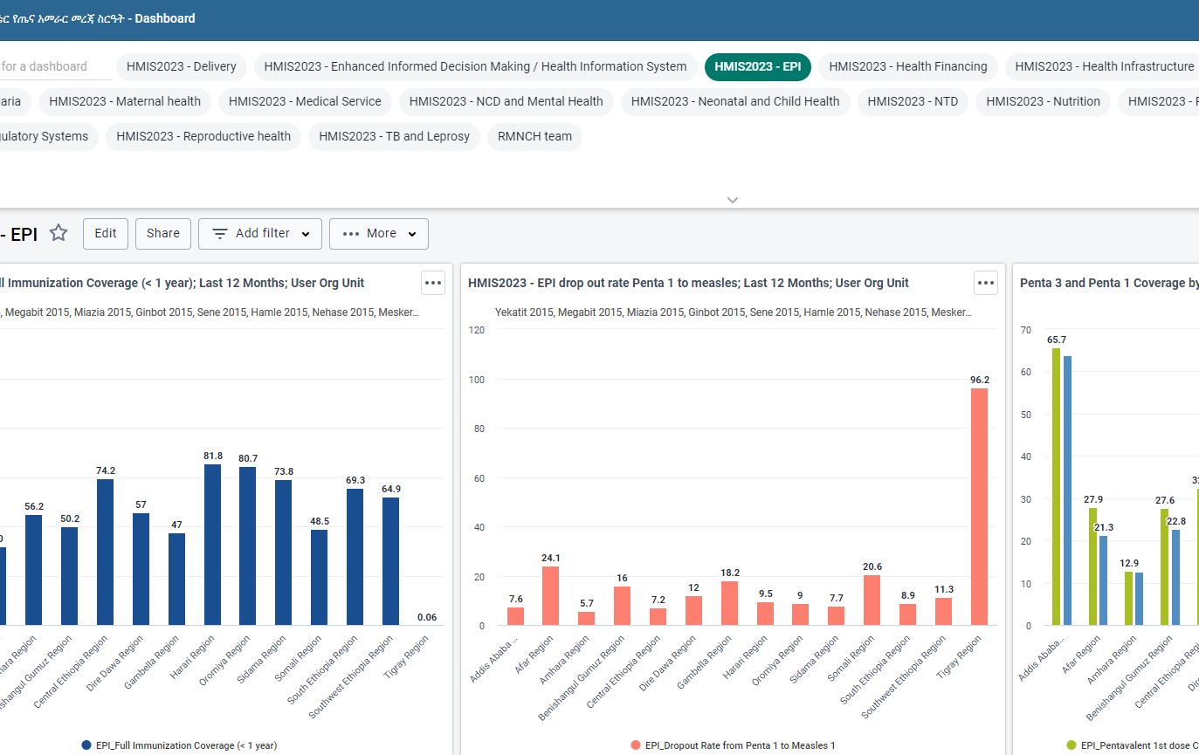
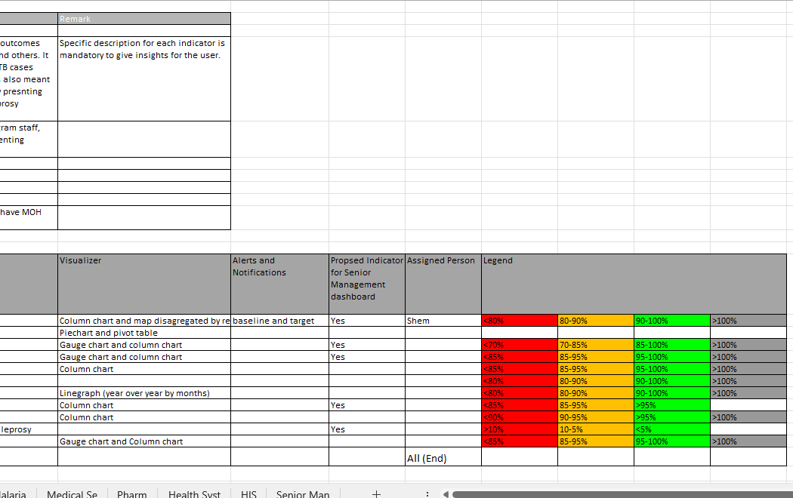
Visualization and Analytics
As of DHIS2 version 2.37, the dedicated Pivot Table app has been integrated into the Data Visualizer app.
DHIS2 Dashboard Enhancements: Standardization
Standardized Dashboards:
Defined indicator descriptions, focused selection, clear visualizations, timely alerts, and consistent legends
Senior Management Focus:
A tailored dashboard emphasizes key metrics for informed decision-making.
Program Coverage:
12 major programs and 22 sub-programs are integrated for a comprehensive dashboard.

Slide 21
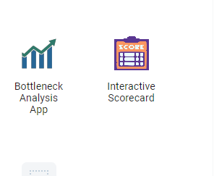
Scorecard and BNA
Ethiopian Calendar Configuration
BNA Draft Intervention Customization
Targeted User Training

Slide 22

Revision of Hospital KPI indicators
Data Entry Expected at Public hospital Level on Monthly and Quarterly Basis
Capturing 30+ data elements and key indicators
Provision of stand-alone training

Slide 23
Integration of MRIS and Rehabilitation
Multi-Sectoral Response Information System (MRIS):
Data Entry Expected at Woreda Level on a Quarterly Basis
Capturing 15+ data elements and key indicators for a multi-sectoral response to HIV services
Provision of stand-alone training
Rehabilitation Information:
Expected Monthly Data Entry at the Facilitates Level
Capturing of 9 Data Elements and Key Indicators to track and manage rehabilitation data
Approximately 40 facilities offer rehabilitation services.
Provision of stand-alone training

Slide 24
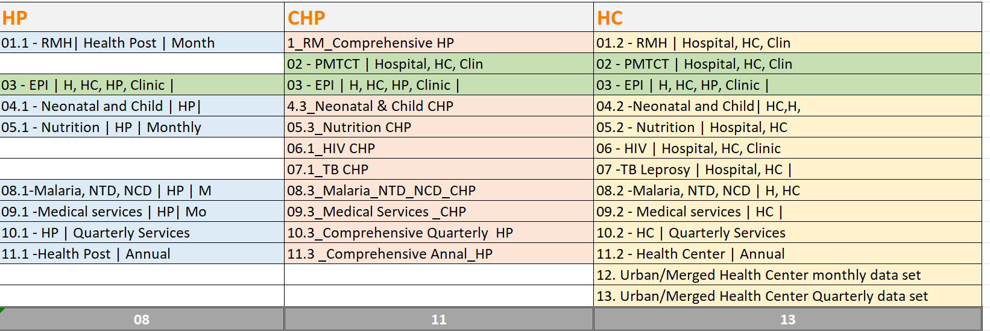
Integration of Compressive health post data set
Expanded dataset for comprehensive health post-services
Currently we have 50 comprehensive health posts in DHIS 2
Introduction of Nine New Datasets for Comprehensive Health Posts

Slide 25

Integration of Urban HC and Merged HP data set
Integration of Health Post and Urban Health Center data for a holistic health center Performance measurement.
Both urban HC and HC with merged HP used the same datasets.
The data entry is expected monthly and quarterly.
No Additional Data elements: Leveraging existing data elements aligned with the 2021 indicator revision.

Slide 26

Integration of Composite IR Score
Automated Calculation Based on Composite Measure
Calculation Methodology Aligned with IR Guidelines
Woreda IR Score: Assessing Overall Performance, Including Woreda Health Office and Supervised Facilities
PHCU IR Score: Measure PHCU Performance, Including Satellite Health Post and Health Center

Slide 27
Integration of Woreda Transformation Dashboard
Dashboard for monitoring and visualizing the transformation progress at the Woreda level.
Automated Calculation Utilizing Composite Measures
Calculation Methodology Aligned with Woreda Transformation Guidelines
Facility-Level Calculation Based on Catchment Population Entered in DHIS2

Slide 28
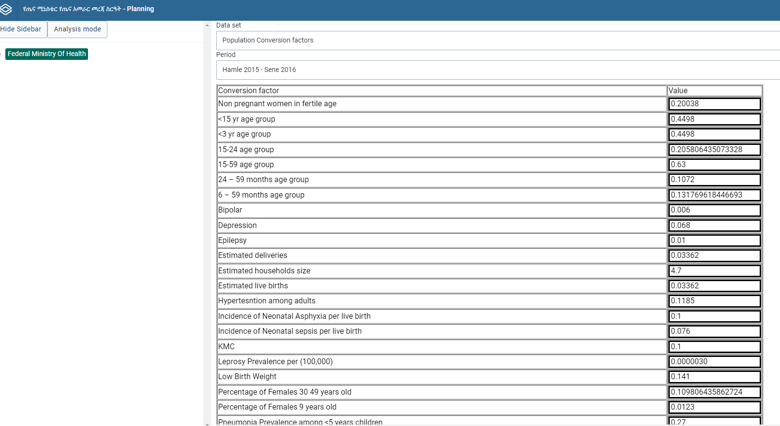
Integration of Woreda based plan
Introduction of a dataset for Woreda-based planning
Baseline Data Automatically Calculated from the Previous Year's Performance
Selection of Indicators for the Woreda-Based Plan Aligned with the DHIS2 Indicator Reference Guide
The customization process is nearing completion.

Slide 29
Introduced new features and enhancements
(DHIS2-V40)

Slide 30

Version 40
Dropping the 2 from the release version numbers
DHIS2 Version 40
This makes it easer to communicate what is the major release numbers
DHIS2" is now the official brand name.
There is no need for abbreviations like "District Health Information System 2."

Slide 31
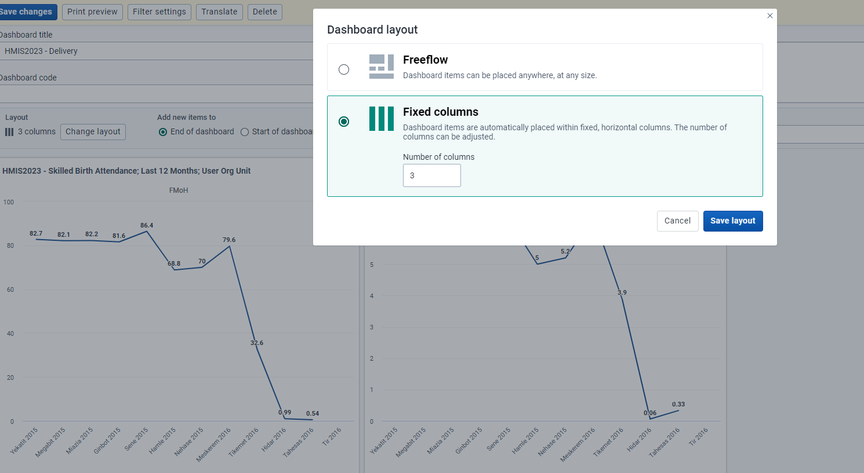
Dashboard default layout:(DHIS v2.37)
Dashboards support automatic configuration as items are added.
Option to select the number of columns for layout.
Users can choose to add new items to the top or bottom.
Items adjust size and shape based on column selection.

Slide 32
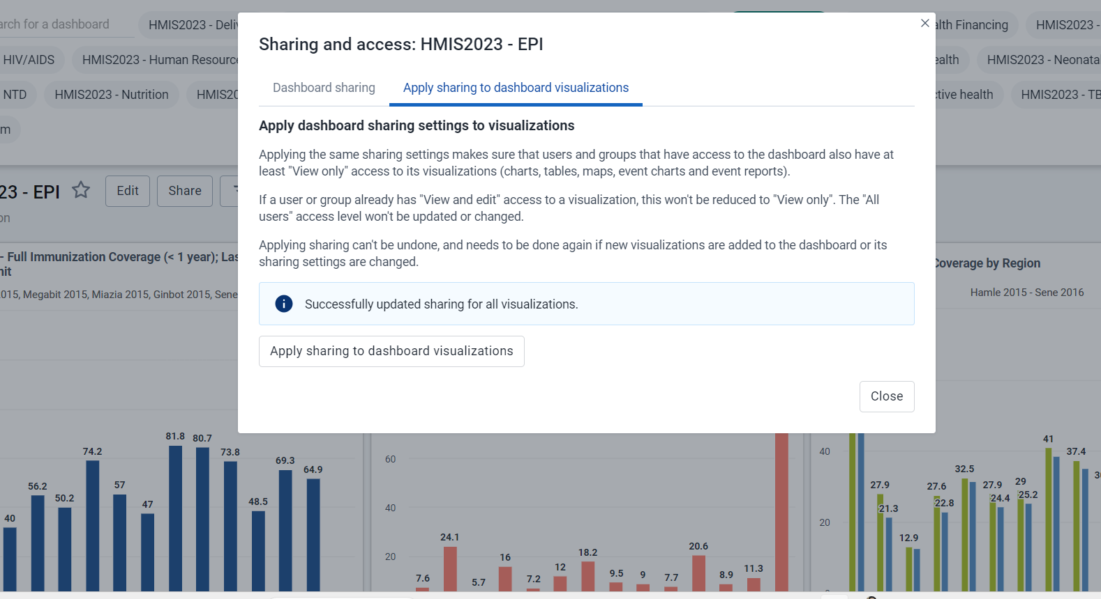
Cascading Dashboard Sharing: (DHIS v2.37)
Share dashboards seamlessly with other users.
Sharing cascades to include items like visualizations, maps, reports, etc.
Simplifies the sharing process, eliminating manual sharing of individual items.

Slide 33
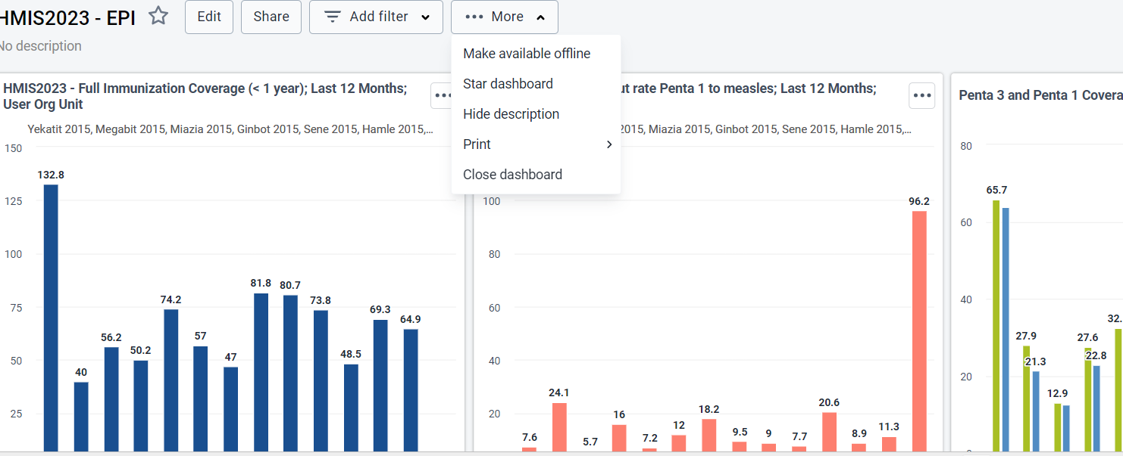
Offline Dashboards:
(DHIS2 v2.37)
Users can now mark dashboards for offline access.
Visualizations and data are stored locally in the web browser for laptops, desktops, and mobile devices.
Offline access allows viewing dashboards without an internet connection.
Note: Filters and interpretations are not supported offline.

Slide 34
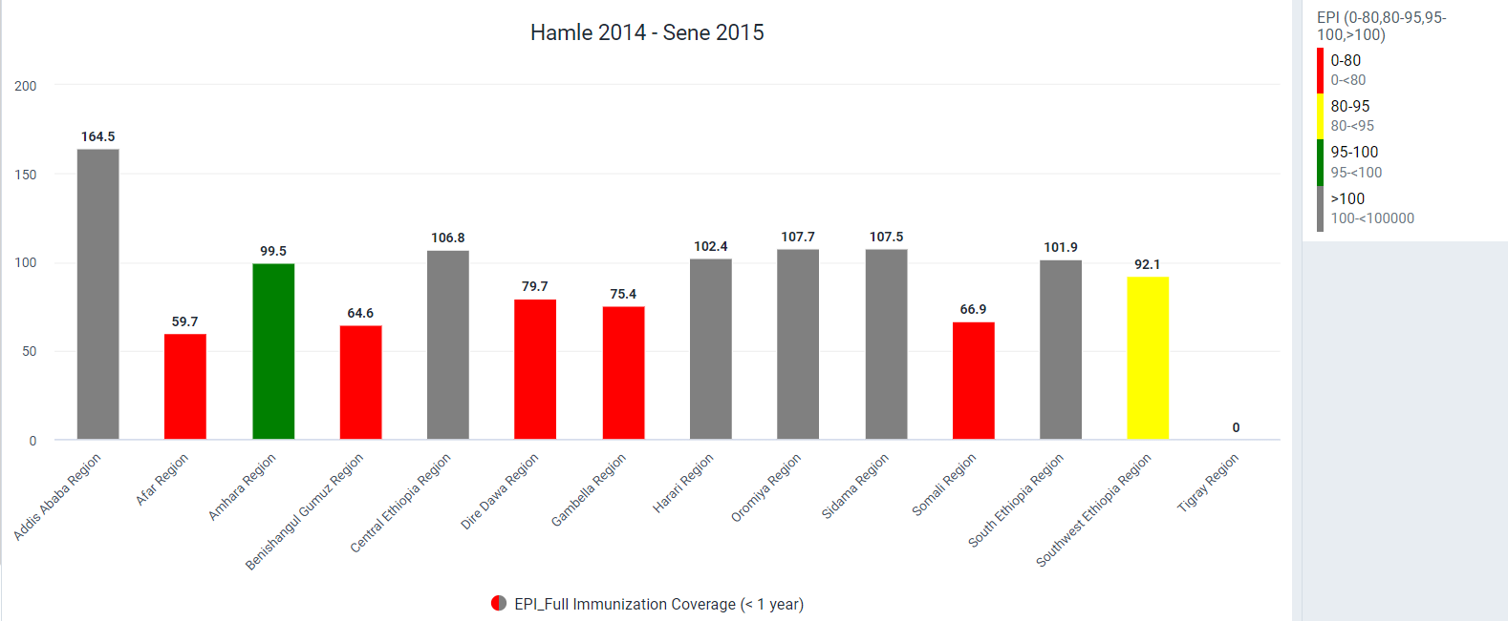
Legend Info in Dashboards (DHIS2 v2.37)
View legend information for pivot tables or charts with applied legend sets.
Enable it from Options > Legend for a better understanding of the data.

Slide 35
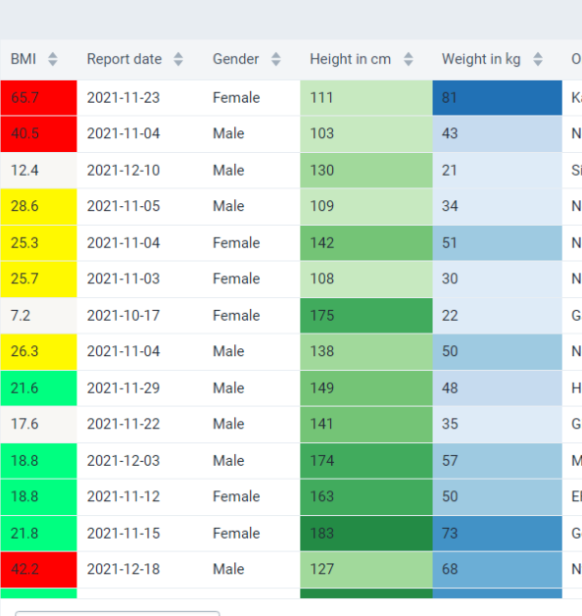
Line Lists on Dashboards:(DHIS2 v 40)
Access line lists directly on dashboards for comprehensive data management.

Slide 36
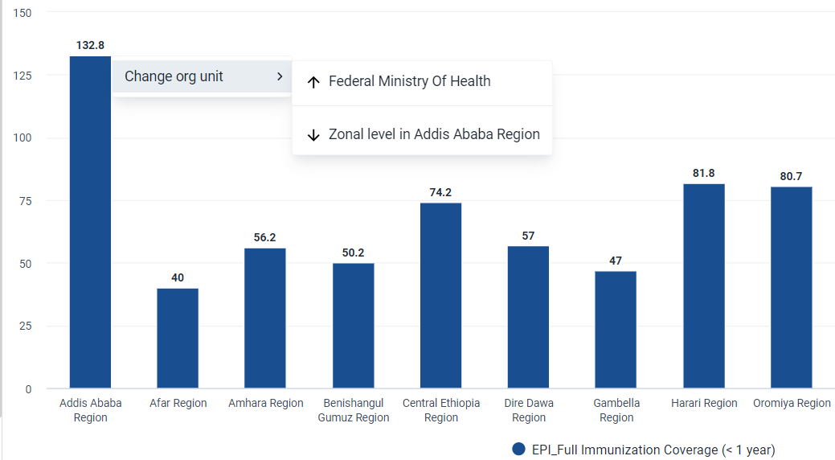
Org Unit Drill Down:
(DHIS2 v2.37)
Bar and column charts allow easy navigation through the organizational hierarchy.
Users can drill down or move up one level with a simple click.
Available unless the organization unit dimension is specified as a filter.

Slide 37
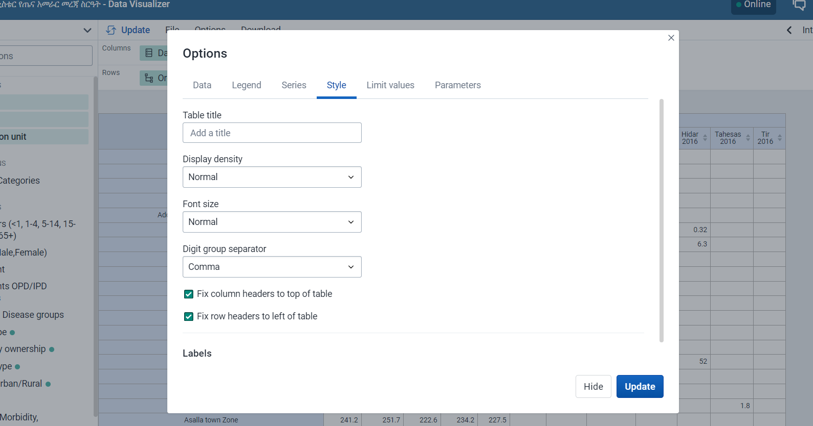
Freeze Row and Column Headers: (DHIS2 v2.37)
Pivot table headers can now be frozen.
Allows scrolling through large tables while retaining header visibility.
Enable it from Options > Style for seamless navigation.

Slide 38
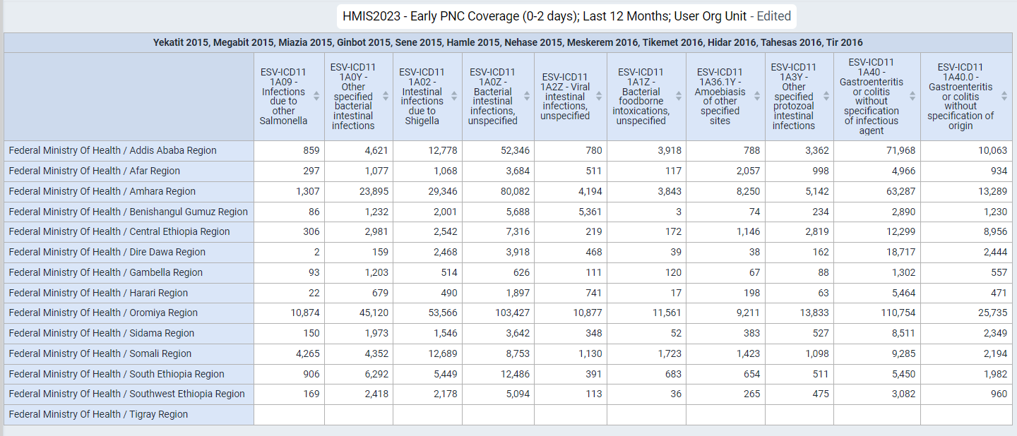
Text Wrapping: (DHIS2 v2.37)
Pivot tables now support automatic text wrapping.
Ideal for displaying narratives and lengthy data.
Enhances readability within the visualizer app.

Slide 39
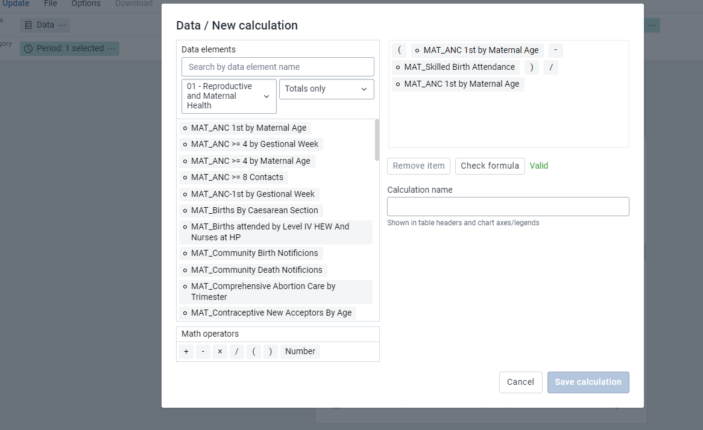
On-the-fly Custom Calculations in Data Visualizer: :(DHIS2 v 40)
Easily create custom calculations directly in the Data Visualizer application.
No admin access is required; calculations are automatically saved to pivot tables.
This feature is ideal for exploring coverage calculations with various population denominators

Slide 40
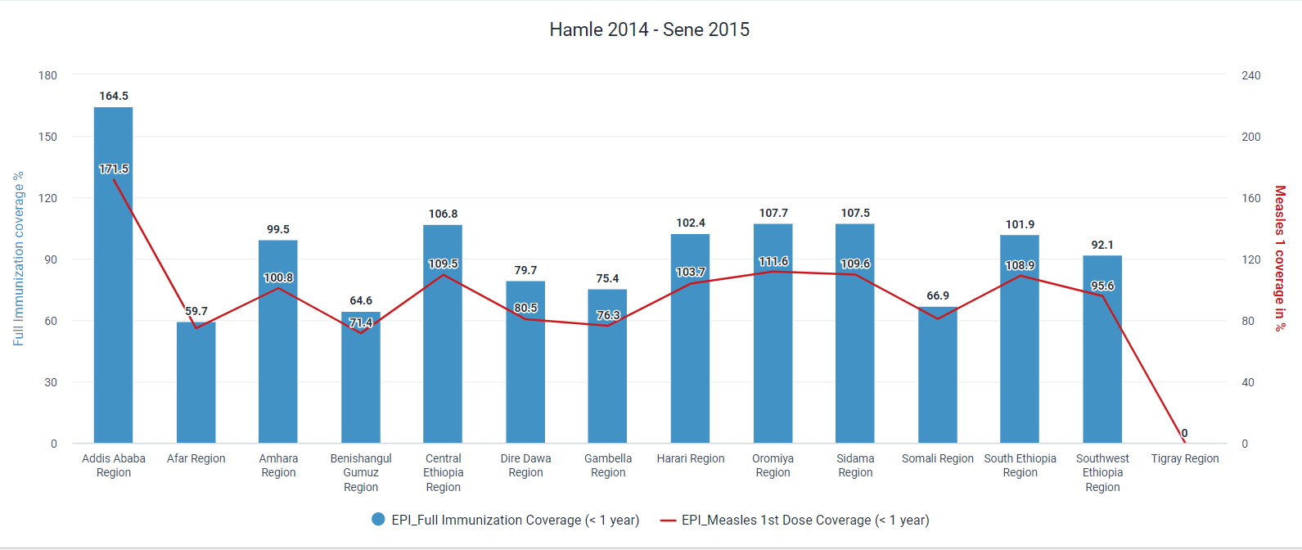
Axis Labels for Multi-Axis Charts:
Customize labels for all axes in multi-axis charts.
Applies to bar, column, and line charts in the Data Visualizer app.
Enhances the clarity and interpretation of data.

Slide 41
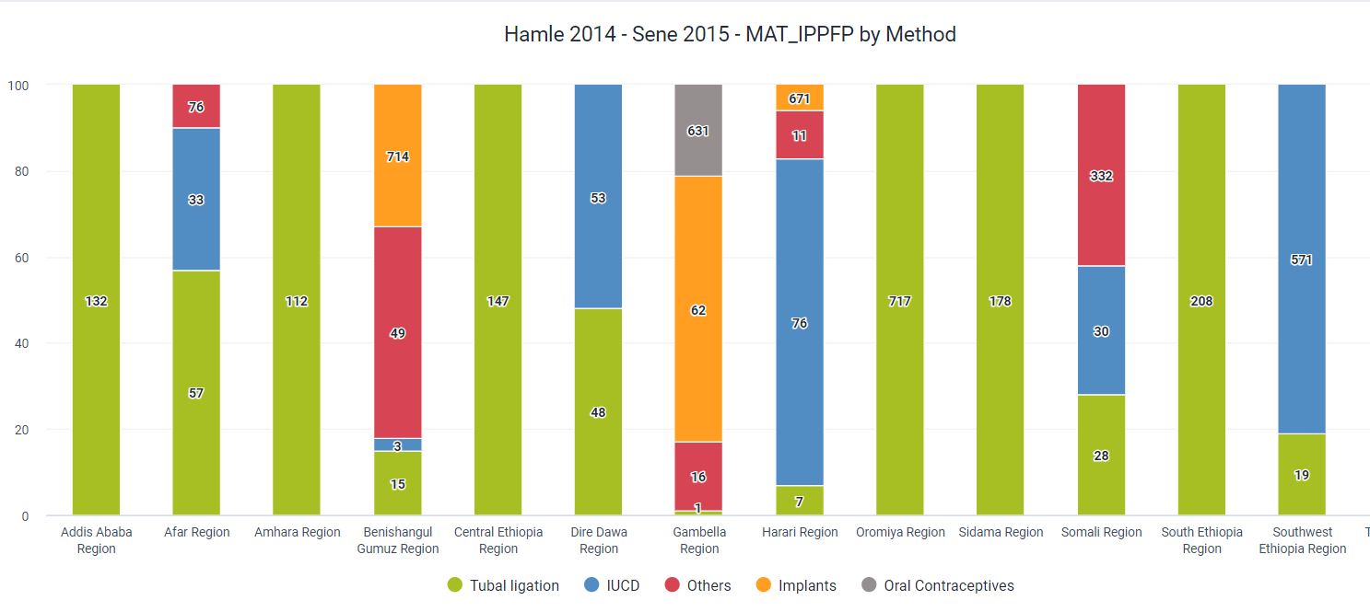
Legend for Stacked Column Charts: :(DHIS2 v 40)
Add legends to stacked column charts for improved data visualization.

Slide 42
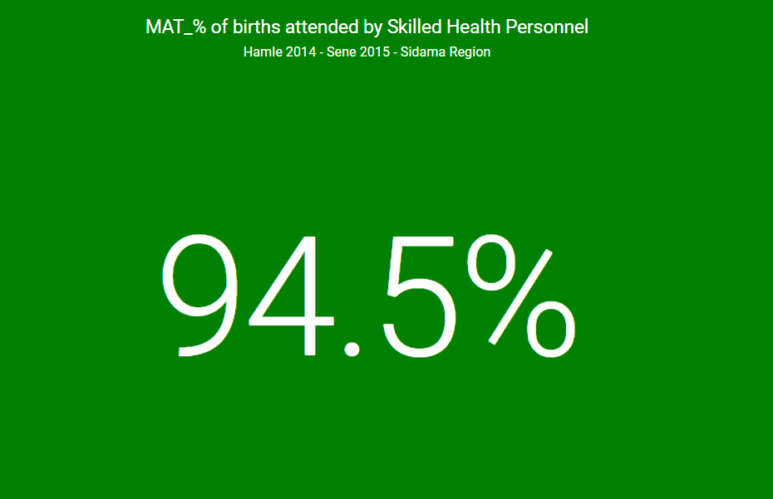
Single Value Charts with Legend Colors: :(DHIS2 v 40)
Apply legend colors to the background of single-value charts.
Enhances visual engagement and understanding of data significance.

Slide 43
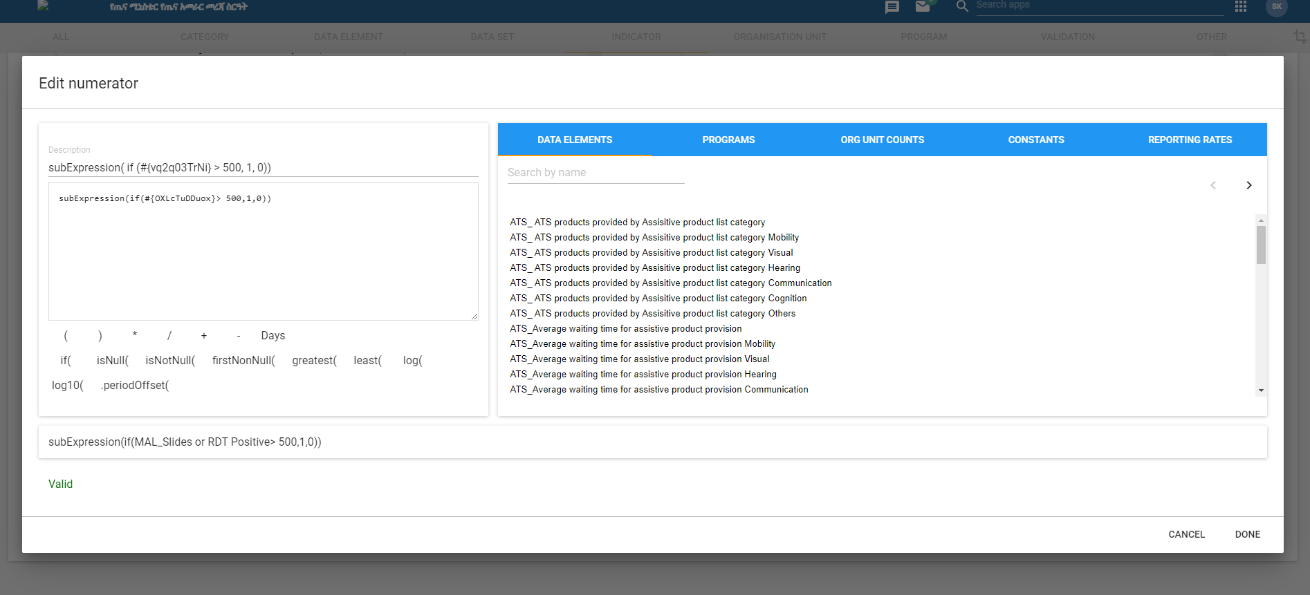
Indicator Sub-Expressions: :(DHIS2 v 2.38)
Indicators count organizational units based on data element comparisons with fixed values.
Example: subExpression(if (#{vq2q03TrNi} > 500, 1, 0))
Description: Counts units reporting over 500 malaria cases within defined period in analytics app.

Slide 44

Predictor Usage in DHIS2: (DHIS2 v 40)
Predictors define aggregate data value generation from expressions containing aggregate data.
Predicted values may be based on data from the same period as well as previous periods.
Data from the same period:
  Predictors utilize data from the same period.
  Example: Counting non-zero data element values across organization units using the expression: if( #{ji7o0ILHuU2}!= 0, 1, 0).
  Result: Stores 1 if a non-zero value exists; otherwise, stores 0.
Data from previous periods:
  Predictors utilize data from previous periods when aggregation functions like sum() or avg() are specified.
  Example: Generating a value as the average plus twice the standard deviation of previous period data using: avg( #{ji7o0ILHuU2}) + 2 * stddev( #{ji7o0ILHuU2}).

Slide 45
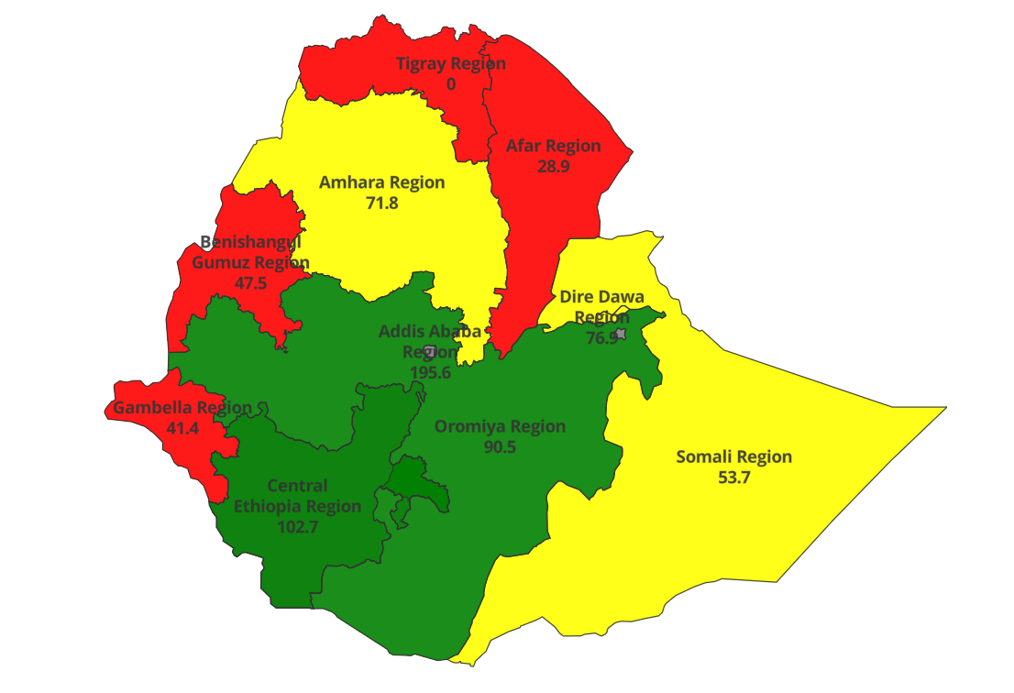
Display values in thematic layers: :(DHIS2 v 40)
Show values directly on maps in thematic layers for enhanced data presentation.

Slide 46
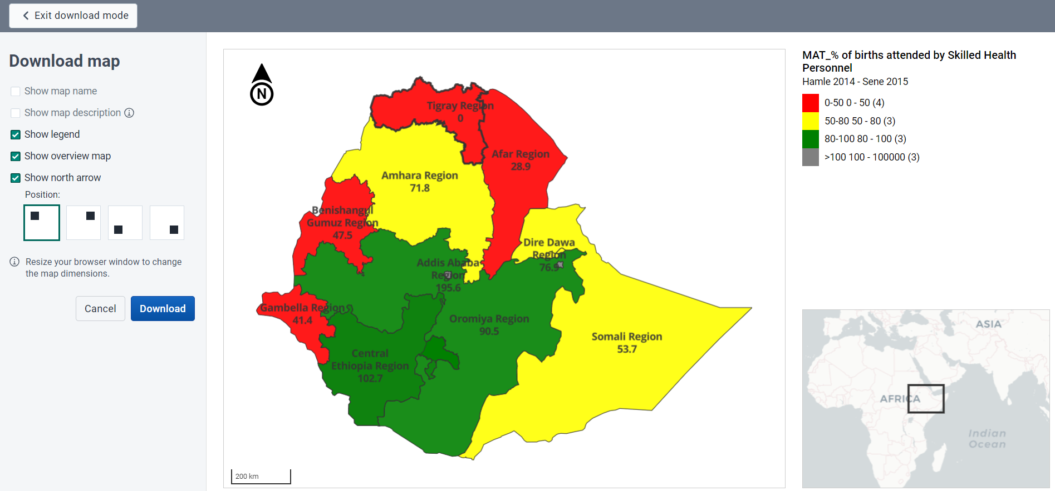
Improved Maps Download: :(DHIS2 v 40)
Download maps with all essential information, including title, description, legend, etc., in one image.

Slide 47
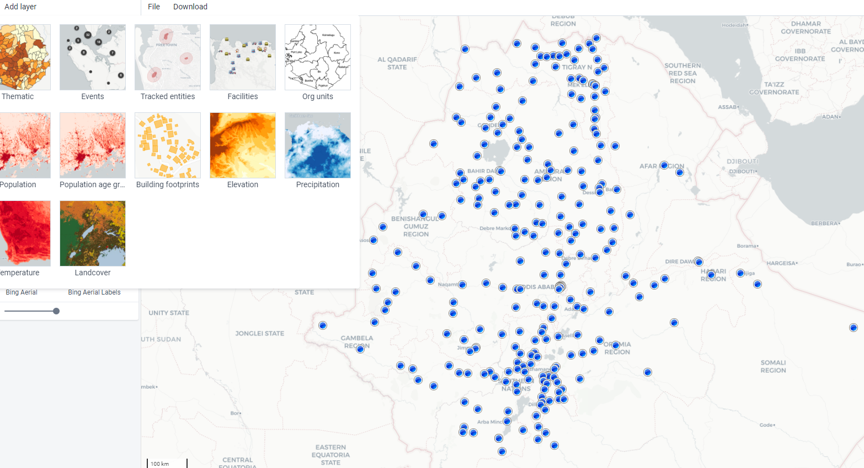
Facility Map Layer: (DHIS2 v2.37)
New map layer in Maps app supports facility registry system in DHIS 2.
Selected level automatically applies when creating a new facility map layer.
Useful in conjunction with new organizational unit profile.

Slide 48
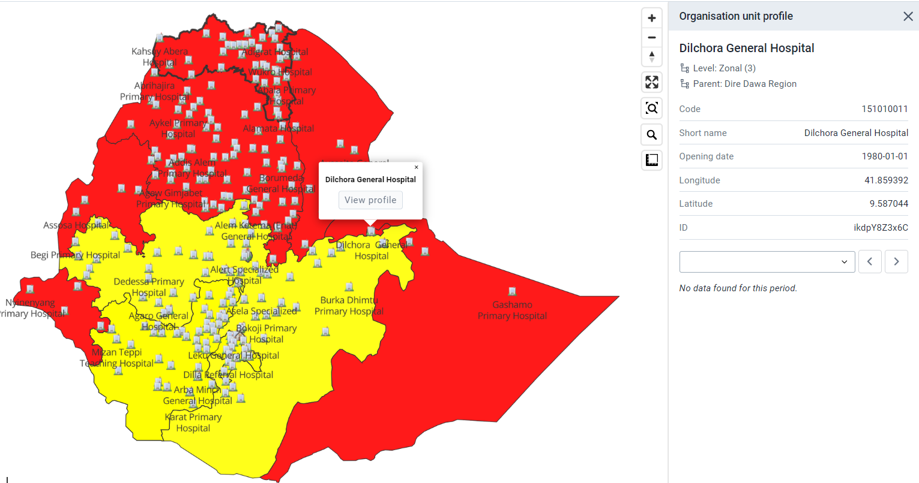
Org unit profile (DHIS2 v2.37)
New Org Unit Profile within the Maps application displays crucial details for each facility directly on the map.
Simply click on a point or facility and select "Show more info" to access the profile.
This powerful feature elevates DHIS2's suitability as a comprehensive facility registry.

Slide 49
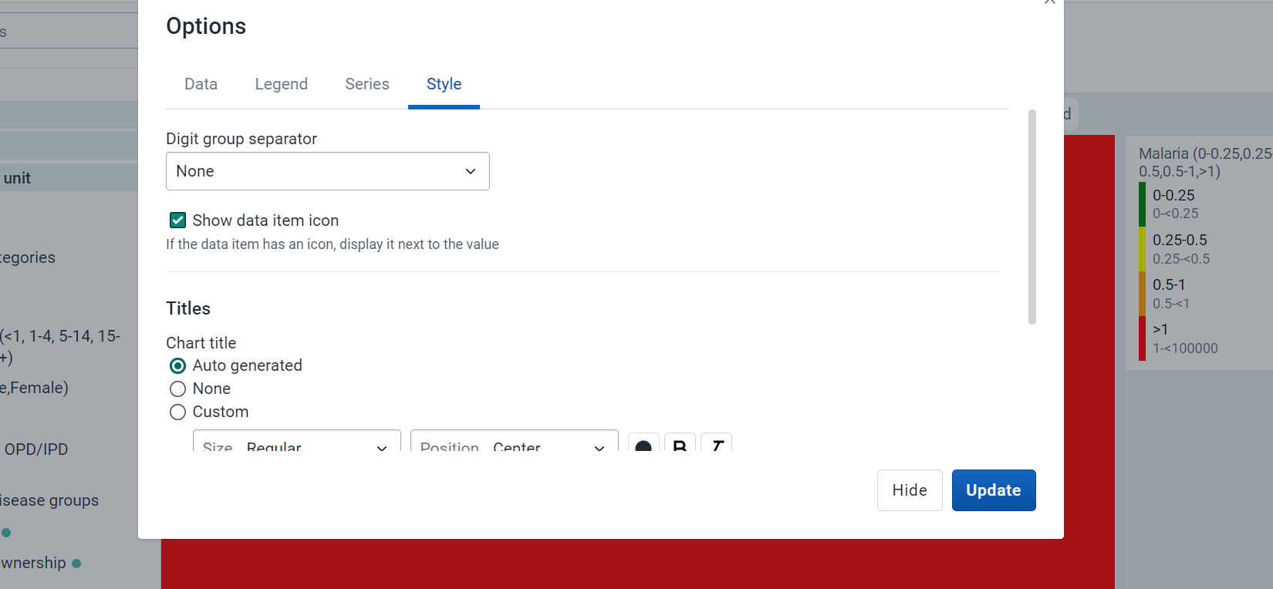
Indicator Icons for Single Value Charts: :(DHIS2 v 40)
Display icons in single-value charts to represent indicators.
Adds visual representation to the data for better comprehension.

Slide 50
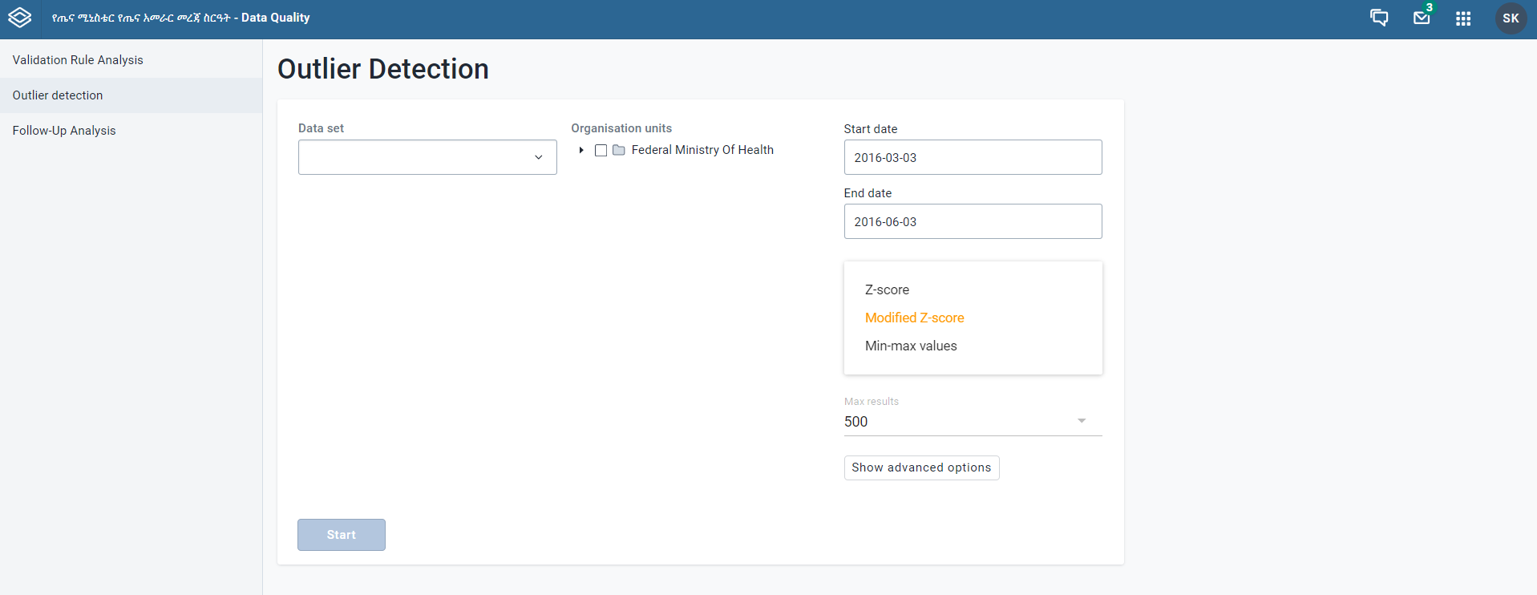
Modified Z-score: (DHIS2 v2.37)
  Introducing outlier detection using the modified Z-score method.
  More resilient towards outliers compared to traditional methods.
  Available in the data quality app for enhanced data analysis.

Slide 51
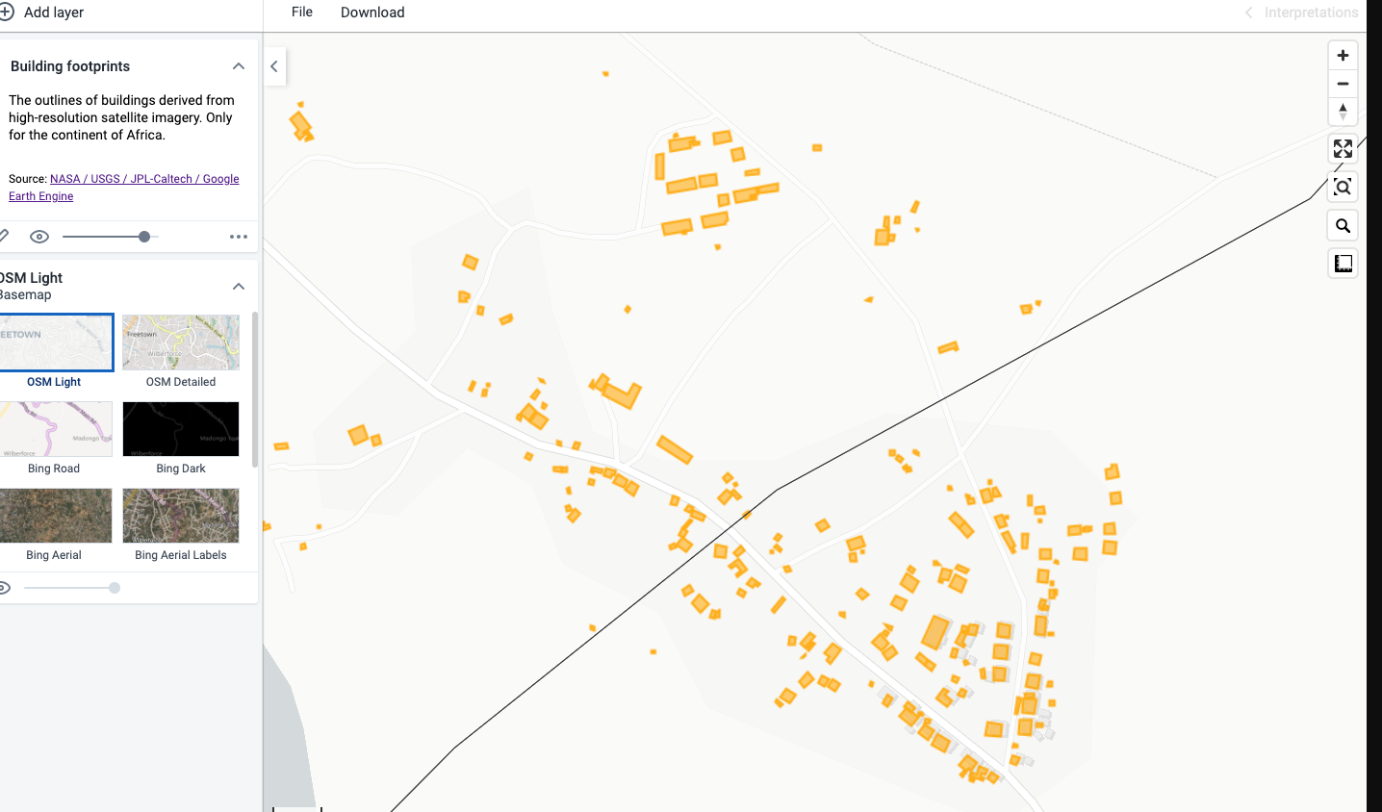
Google Earth Engine Building/Structures Layer:
View structure outlines from Google's Open Building dataset in the Maps app.
Beneficial for population estimation, urban planning, and humanitarian response.
Improved performance using web workers.

Slide 52
Hands-on Exercise-1
Data Visualizer for Custom Calculation:
Given That the national population stands at 120 million,
The estimated percentage of surviving infants (CF) is 3.163642%.
Data: Number of children vaccinated against measles-1, Penta 1, and Penta 3.
Period: 2015 EFY
Organization Unit: National (MoH)
Create custom calculations
Define the custom calculation as follows: Calculation Name: Measles, Penta 1, and Penta 3 Vaccination Coverage
Save the results in a pivot table as a favorite.
Convert the pivot table into a bar chart and Share Results for your friends

Slide 53
Hands-on Exercise-2
Data Visualizar for Org Unit Dril Down:
Data: Inpatient mortality rate
Period : last 12 months
Org Unit: Your user org
Layout using the column chart canvas.
  Series = org unit
  Category = Period,
  Filter = Data
Org Unit Drill Down:
  Select the high number of Inpatient mortality rate occurs period.
  Click on the arrow icon next to the selected period on the column chart canvas.
  Explore the available potential outlier of sub-levels of organization units (e.g., District Health Offices, Health Centers, Clinics).
Save the report as favorite
Download it as Excel

Slide 54
Hands-on Exercise-3
Pivot table: Freeze Row and Column Headers
Data: PNC Visit
Period : last 12 months
Org Unit: zonal(Group)
Layout
  Column =Data, Period
  Row = org unit
Freeze Row and Column Headers:
  Navigate to Options > Style > Fix Column Headers to Top of Table and Fix Row Headers to Left of Table.
  Enable both options to freeze row and column headers for easier navigation through large pivot tables.

Slide 55
Hands-on Exercise-4
Data Visualizer: Customize Axis Labels for Multi-Axis Charts
Data: Malaria cases tested; Malaria cases positive
Period: last 12 month
Org Unit: Your user org
Layout
  Series =data (Malaria cases tested & positive)
  category dimension= Period
  Report filter =org unit
Convert Malaria cases tested to a bar chart and Malaria cases positive to a Line graph
Customize axis labels by providing descriptive names or units for each axis (e.g Malaria cases tested , Malaria positive cases).
Save the chart as a file using initials - What, Where, When, and add Description.
Download it as PDF

Slide 56
Hands-on Exercise-5
Year over year(line) chart
Data: Number of under 5 children treated for pneumonia.
Period: 2015,2016, by Months per Year
Org Unit: Your user org
Layout
  series) ➔ Period (category dimension)➔ Period
  Report filter ➔ Data (Data Element), org unit
Save the chart as a favorite using initials - What, Where, When
Download it as pdf

Slide 57
Hands-on Exercise-6
Scatter plots
Data: Pregnant women tested for syphilis, ANC1vist
Period: last year
Org Unit: Your user org by facilities
Layout
  Vertical Axis = data
  Horizontal Axis = data
  Points= org unit
  Report filter = Period
Calculate Outlier detection using a modified z score and threshold factor =3 sd.
Save the chart as a file using initials - What, Where, When, and add Description.
Download it as an Image (.png)
Add it to your PowerPoint presentation

Slide 58
Hands-on Exercise-7
DHIS2 Maps :Thematic Layer
Data: Clients testing positive for HIV (at VCT) by Bubble map
Period: This Year
Org Unit: Your user org
Layout
  Thematic layer= Data
  Ensure that the thematic layer is configured to display data.
Save the chart as a file using initials - What, Where, When, and add Description.
Download it to png or pdf with Legend
Add it to your PowerPoint presentation

Slide 59
Hands-on Exercise-8
DHIS2 Maps :Improved Maps Download
Data: Birth attended by skilled personnel
Period: last 12 month
Org Unit: Your user org by woredas
Layout
  Thematic layer➔ Data
Add legend for woredas data
Save the chart as a file using initials - What, Where, When, and add Description.
Add a data table and download your maps in GeoJSON format
Add it to your PowerPoint presentation

Slide 60
Hands-on Exercise-9
DHIS2 Maps
Data: ANC1 for each zone
Period : last quarter
Org Unit: Your org unit
Layout
  Boundary layer ➔ region
  Thematic layer➔ ANC1
  Facility layer ➔hospital by type
Save the report as favorite (the name should include the dimensions)
Convert the pivot table to bar chart and download it to png or pdf
Add it to your PowerPoint presentation

Slide 61
Hands-on Exercise-10
DHIS2 Dashboard Module:
Create or Select Dashboard:
  Choose an existing dashboard containing relevant data visualizations, or create a new dashboard based on your analysis requirements.
Share Dashboard:
  Click on the "Share" or "Share Dashboard" button to access the sharing options.
  Enable the Cascading Dashboard Sharing feature to automatically share all items within the dashboard, including visualizations, maps, reports, and data elements.
  Specify the users or user groups with whom you want to share the dashboard.
Configure Legend Info:
  Access the settings or options for each visualization or map within the dashboard.
  Enable the option to display legend info for each visualization where a legend set is applied.
  Customize the legend settings, such as legend position, orientation, and format, to ensure clarity and consistency across visualizations.
View Shared Dashboard:
  Log in with the credentials of the shared users or user groups to access the shared dashboard.
  Navigate to the dashboard section to view the shared dashboard with all its components.
Interact with Dashboard:
  Explore the shared dashboard by interacting with the visualizations, maps, and reports.

Slide 62
Hands-on Exercise-11
Develop and analyze the EPI scorecard under various scenarios.
Develop and analyze the TB scorecard under various scenarios.
Calculate the LQAS for service data for a specific period in 2016 EFY using the Monthly Common Dataset.
Calculate the compliance of hospital medical service dataset content for your region within the specified period.

Slide 63

Challenges and Considerations
Legacy Data and Offline Facilities
MFR Data Quality and Coordination
Outdated desktop computer

Slide 64

Next Steps and Priorities
Finalize the Legacy Data Migration
MFR interoperability
Prioritize hardware upgrades: procure computers
Address connectivity gaps
Optimize ICT Infrastructure
Governance and Implementation: official endorsement for the DHIS2 governance protocol and finalizing the implementation roadmap
Invest in capacity-building
Mobile Android App Ethiopian Calander configuration

Slide 65
Regional Cascading and Offline Deployment Plans

Slide 66
Regional Cascading and Offline Deployment Plans: Outline
Background:
  Briefly describe the geographic scope of your region and the nature of the offline deployment needed
Deployment Strategy:
  Offline Deployment Plan: Identifies critical tasks and backup systems necessary for data management during offline scenarios.
Regional and Cascading Training Approach and Strategy:
Training Participants, Schedule, and Budget:
  Draft timeline for training sessions,
  Participants involved and
  Estimated budget requirements.
National Support:
  Briefly mention 1–2 areas where national support would be helpful.
Challenges: Briefly mention 1-2 potential challenges and proposed solutions.
Recommendations

Slide 67


Regional Presentation and Discussion
Prepare both a Word document and presentation slides (no more than 15 slides).
Each region presents for 10 minutes.
Followed by a broader discussion.

Slide 68

Thank you

